Slide 1

Replication

Slide 2
Structure
Motivation
Classification of Replication Approaches
Partial Replication
Lazy Master Replication
Distributed Log

Slide 3
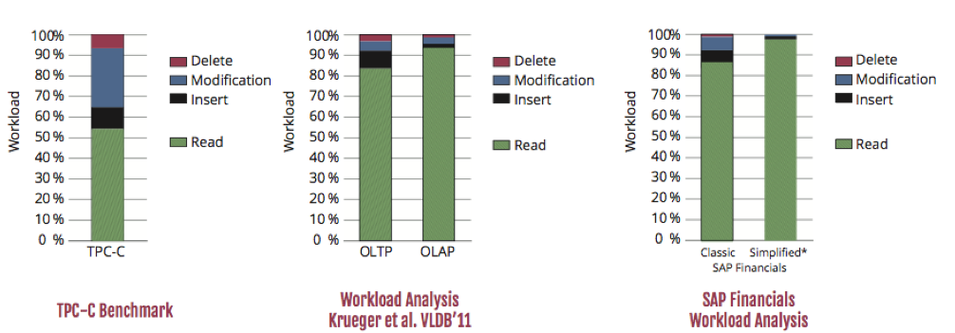
Motivation
Enterprise Workload Characteristics
Unified database system: OLTP and OLAP workload on a single database
Heavy read-only OLAP queries responsible for the majority of the workload
Complex OLAP queries on transactional schema

Slide 4
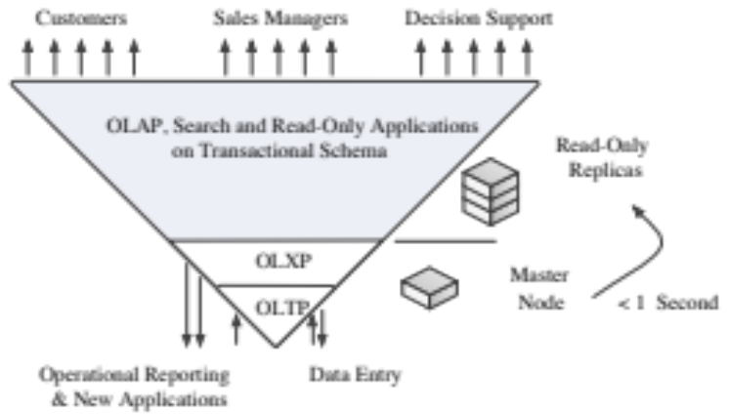
Motivation
Increasing Demand for Processing Capabilities
New enterprise applications ..
  .. attract a growing number of users
  .. issue increasingly complex queries
  .. encourage interactive data exploration
  .. require scalability
Scale-out is more scalable, cost-efficient, and resilient than scale-up
Replication does not require distributed query processing, but is limited to scale (in contrast to partitioning)

Slide 5
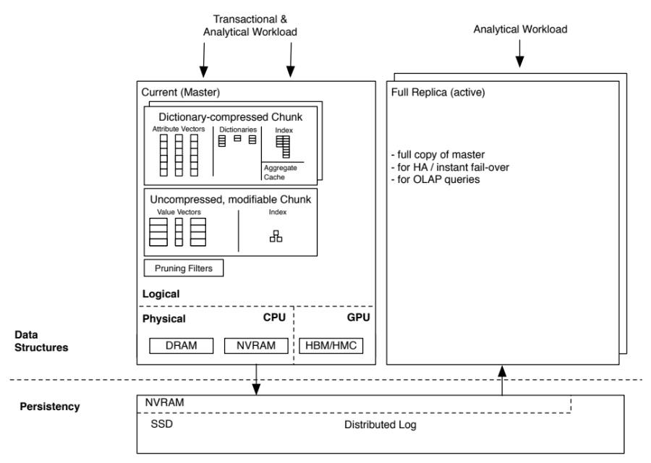
Active Master Replication
A single node, called master, is responsible for transaction handling
Active replica nodes are used for read-only workload (in contrast to passive replication)

Slide 6
Replication Approaches
Eager vs. lazy
Master vs. group
Logical vs. physical synchronization
Homogeneous vs. heterogeneous

Slide 7
Replication Approaches
Eager vs. Lazy Replication
Eager replication:
  Synchronizes replicas as part of transaction
    + availability
    - transaction latency
Lazy replication:
  Postpones synchronization of replicas
    - Availability / failover
    + transaction latencies
    + optimize synchronization by grouping logs in messages

Slide 8
Replication Approaches
Group vs. Master Replication
Group replication:
  Allows data-altering transactions on every node
    + scalability
Master replication:
  A dedicated node is responsible for transaction handling
    + avoids inter-node coordination

Slide 9
Replication Approaches
Logical vs. Physical Synchronization
Logical synchronization:
    Describes data changes on higher level, e.g., SQL statements
    + log size does not dependent on amount of changed data
    - reexecute queries for recovery
Physical synchronization:
    Changes with regard to the used data structures
    + works with dictionary encoding
    + general approach

Slide 10
Replication Approaches
Homogeneous vs. Heterogeneous
Homogeneous replication:
  Replicas are exact mirrors of master
    + load balancing
    + simplicity
    - memory consumption
Heterogeneous replication:
  Replicas store portions of data or optimized data structures
    + memory consumption
    + functionality
    + speed
    - complexity

Slide 11
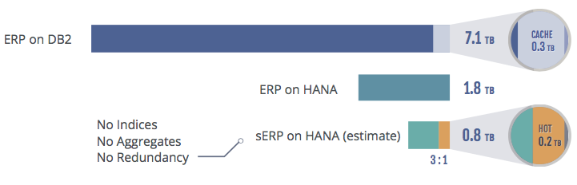
Replication Approaches
Partial Replication - A Subset of Heterogeneous Replication
  How to optimize individual replica?
      Reduce the memory consumption (and, thus, cost) of replicas
      Process a specific subset of queries more efficiently
      Add additional functionality
    Partial replicas store a subset of the entire dataset
    Our scope: Master replication without distributed query processing

